Slide 1


Developing Grit, Resilience, and Growth Mindset in the Workplace
Elissa Jacko

Slide 2
Introduction to Grit and Resilience
Resilience is the ability to recover and grow stronger after adversity, while grit is the passion and perseverance to pursue long-term goals despite obstacles.

Slide 3
Understanding Grit: Components and Characteristics
Examples of Grit in Professional Settings
How Grit Impacts Long-Term Success
1
Passion and Perseverance Explained
2
3
Grit combines passion and perseverance, enabling sustained effort toward long-term goals despite setbacks.
Professionals show grit by persisting through challenges, maintaining motivation, and adapting to change.
Grit enhances resilience, learning, and consistent effort, often predicting achievement beyond talent alone.

Slide 4
Understanding Resilience: Components and Characteristics
Emotional Resilience and Adaptability
Emotional resilience involves understanding and managing feelings, adapting creatively to adversity, and maintaining mental health through optimism and emotional intelligence.
Coping Strategies and Workplace Role
Effective coping strategies like mindfulness and support systems enhance resilience, which is crucial for workplace performance by fostering recovery, independence, and positive relationships.
1
2

Slide 5




Challenges Faced by Adults Working with Children
Emotional Demands and Burnout Risks
Adults face significant emotional stress managing children's needs, risking burnout characterized by exhaustion and reduced accomplishment.
1
Balancing Empathy with Professional Boundaries
Caregivers must balance empathy with clear boundaries to avoid emotional strain and maintain objectivity.
2
Impact of Workplace Culture on Stress Levels
3
Supportive workplace culture reduces stress, while high workloads and poor support increase burnout risks.
Strategies for Sustaining Well-being
4
Resilience-building and supportive organizational practices are essential to maintain adult caregivers' effectiveness.

Slide 6
Impact of Workplace Culture on Stress Levels
3
Supportive workplace culture reduces stress, while high workloads and poor support increase burnout risks.
Strategies for Sustaining Well-being
4
Resilience-building and supportive organizational practices are essential to maintain adult caregivers' effectiveness.

Slide 7
Strategies to Develop Grit in Adults
Setting Long-Term Goals and Maintaining Motivation
Building Perseverance Through Incremental Challenges
Encouraging Reflection and Learning from Failure
Establishing clear, long-term objectives helps sustain focus and drive over extended periods, essential for developing grit.
Analyzing setbacks as learning opportunities promotes growth mindset and continuous improvement in grit development.
Gradually increasing difficulty in tasks fosters resilience and strengthens the ability to persist despite obstacles.

Slide 8
Activity
Can you name a time when you felt yourself actively developing grit or resiliency?

Slide 9



Strategies to Build Resilience in Adults
Stress Management Techniques
Adults can reduce stress impact by using mindfulness, relaxation exercises, and effective time management strategies.
1
Emotional Regulation Skills
Developing the ability to express emotions appropriately helps maintain confidence and hope during challenging times.
2
Support Networks and Peer Mentoring
Building social connections and mentoring relationships provides emotional support and promotes resilience recovery.
3

Slide 10
Introduction to Growth Mindset
A growth mindset is the belief that abilities can be developed through effort, promoting learning, resilience, and valuing feedback.
Fixed mindset views abilities as static, causing fear of failure; growth mindset embraces challenges and continuous improvement.
Growth mindset enhances adaptability, creativity, and motivation, helping adults model continuous learning and problem solving.

Slide 11
Encouraging a Growth Mindset in the Workplace
Leadership’s Role in Modeling Growth Mindset Behaviors
Promoting Continuous Learning and Curiosity
Leaders demonstrate commitment to learning by sharing challenges and fostering a culture valuing effort and progress over fixed abilities.
Organizations offer learning opportunities and encourage curiosity, stretch goals, and collaboration to foster intrinsic motivation and adaptability.
Providing Constructive Feedback Focused on Effort and Strategies
Feedback emphasizes effort and learning strategies, encouraging employees to view setbacks as opportunities for skill development.
1
2
3

Slide 12
Practical Techniques to Foster Growth Mindset
Goal-setting aligned with growth principles
Set realistic yet challenging goals focusing on learning and personal development, breaking objectives into manageable steps to reinforce motivation.
1
Celebrating progress and effort
Recognize effort, strategies, and improvement to cultivate a culture valuing learning from mistakes and encouraging perseverance.
2
Encouraging risk-taking and learning from mistakes
3
Support experimentation without fear, reframing mistakes as feedback, with leaders modeling openness to learning and challenges.

Slide 13
Building Self-Efficacy Among Adults
Understanding Self-Efficacy and Its Impact on Performance
Techniques to Boost Confidence and Reinforce Growth
Self-efficacy influences motivation, perseverance, and resilience, enabling adults to set goals and overcome challenges effectively.
Mastery experiences and positive verbal reinforcement build competence and encourage persistence through structured challenges and feedback.

Slide 14
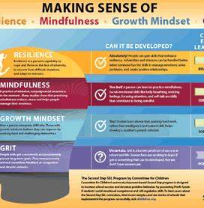
Integrating Grit, Resilience, and Growth Mindset
Interrelation of Grit, Resilience, and Growth Mindset
Grit, resilience, and growth mindset collectively support adult development by fostering perseverance, adaptive capacity, and belief in growth through effort.

Slide 15
Leadership’s Role in Fostering a Supportive Environment
Leadership Styles That Promote Grit and Growth Mindset
Training Leaders to Recognize and Nurture Traits
Building a Culture of Psychological Safety
1
2
3
Effective leaders foster grit and growth mindset by encouraging learning, persistence, and positive adaptation to challenges.
Leaders create psychological safety by promoting open dialogue and viewing mistakes as growth opportunities.
Leadership training equips managers to identify and nurture grit and resilience through coaching and team discussions.

Slide 16




Overcoming Barriers to Change
Common Obstacles in Developing Traits
1
Resistance to change, low confidence, lack of skills, unclear goals, unsupportive culture, and mental health challenges hinder progress.
Strategies to Address Resistance
2
Create safe environments, communicate clearly, celebrate small wins, provide training, model behaviors, and offer constructive feedback.
Sustaining Momentum Over Time
3
Continuous support, clear expectations, leadership modeling, and regular reflection are key to maintaining long-term development.
Importance of Supportive Culture
4
A culture encouraging risk-taking, learning from failure, and autonomy fosters resilience and growth mindset effectively.

Slide 17
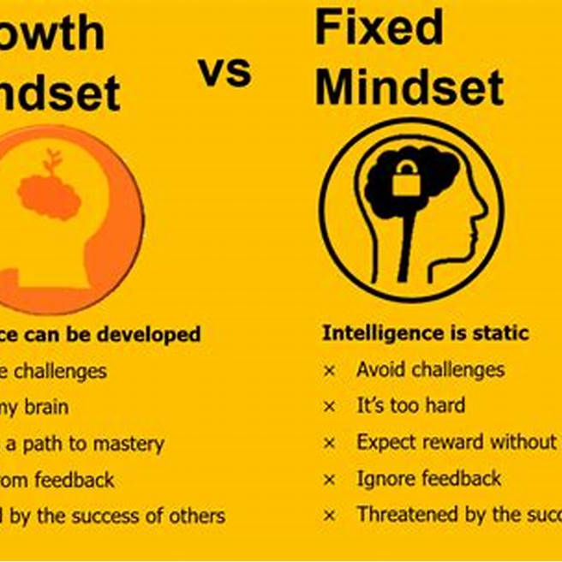

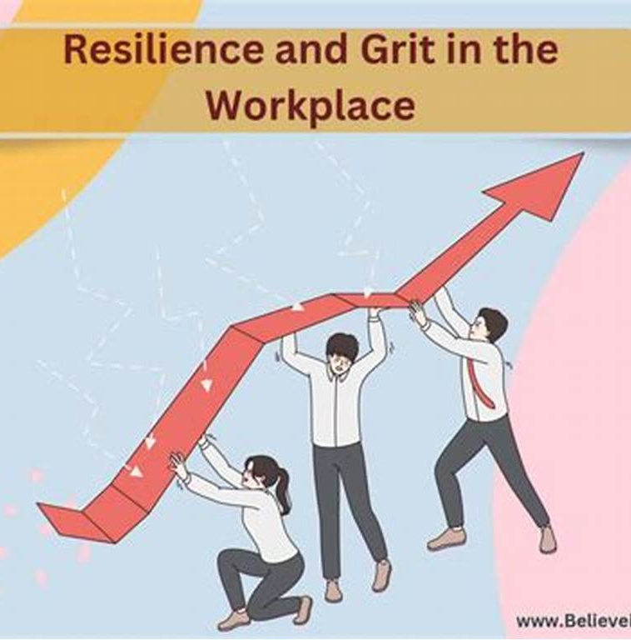
Monitoring and Evaluating Progress
Establishing Clear Benchmarks
Gathering and Utilizing Feedback
Recognizing Progress and Achievements
Set measurable goals reflecting improvements in grit, resilience, and growth mindset among employees.
Collect input through surveys and interviews to identify effective practices and areas for improvement.
Celebrate milestones publicly to foster motivation and reinforce positive behaviors within the organization.

Slide 18



Tips for Sustaining a Positive Workplace Culture
Encouraging Open Communication and Feedback
1
Create a safe environment for sharing ideas and concerns to promote trust and collaboration.
Recognizing and Rewarding Effort and Improvement
2
Acknowledge perseverance and constructive risk-taking to motivate ongoing development.
Maintaining Flexibility and Adaptability
3
Support work-life balance with flexible hours or a flexible work setting to prevent burnout and sustain performance.

Slide 19
Encouraging Peer Support and Collaboration
Building Communities of Practice
Facilitating Knowledge Sharing and Mutual Encouragement
Communities of practice enable workers to share strategies, solve problems, and support each other, fostering resilience and grit.
Structured dialogue and peer mentoring promote feedback, celebrate successes, and treat setbacks as shared learning.

Slide 20
Activity
Think of a difficult circumstance in your life that has been concerning you. Write down some details about the event. What would you tell a friend in that situation? What tone would you use? What actions would you take?

Slide 21
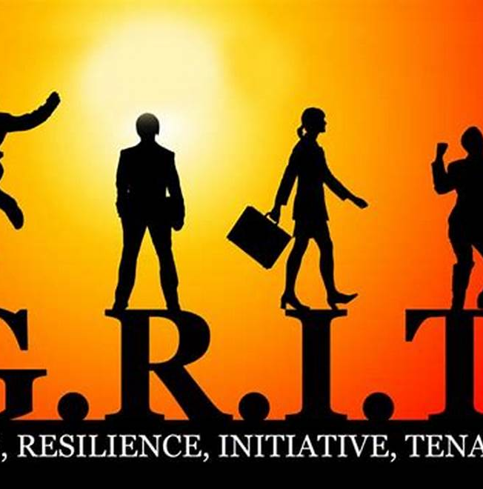

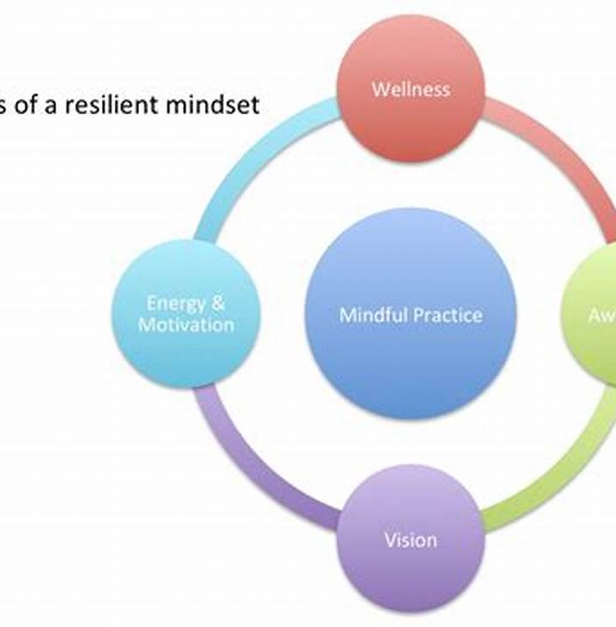
Resilience Role Models and Storytelling
Sharing Stories of Overcoming Adversity
Rewriting Negative Narratives
Facilitating Mindset Shifts
Encouraging growth-focused perspectives through storytelling promotes a resilient culture and collective strength in teams.
Sharing personal or observed experiences of grit highlights perseverance and strength, building resilience in the workplace.
Consciously crafting positive versions of anxiety-inducing stories fosters control and optimism in interpreting experiences.

Slide 22
Activity: Story Telling
We can adjust our paradigms by re-creating narratives we tell ourselves. We can get stuck in re-playing the same stories, which may not be helpful or productive. By creating a healthier storyline, we foster our sense of control and how we interpret events.
Consider an example in your life where you continue to repeat a story that produces worry or anxiety. Try writing out a new version with a more positive interpretation. Recognize how you feel in the process.

Slide 23
Acts of Kindness and Gratitude
Encouraging Daily Acts of Kindness
Expressing Gratitude Regularly
Boosting Happiness and Resilience
Promote simple daily kindness, such as acknowledging or assisting one person each day to foster a supportive environment.
Regular gratitude helps individuals and teams focus on positive experiences, enhancing stress coping abilities.
Incorporating kindness and gratitude into routines creates happier, more resilient employees and strengthens community.

Slide 24
Addressing Mental Health and Well-being
Role of Mental Health in Building Resilience
Access to Counseling and Support Services
Encouraging Work-Life Balance
Flexible work arrangements and wellness programs help reduce stress and prevent burnout, supporting sustained performance.
Mental health is crucial for resilience, enabling individuals to adapt and maintain emotional balance under stress.
Providing counseling, hotlines, and peer support fosters a safe environment for discussing mental health without stigma.

Slide 25

Body Scan Activity
Body scan is one form of mindfulness meditation, focused on the physical experience of mindfulness. It is a technique that hones your attention on different areas of your body to gain awareness and optimize your sensation. Scientific research indicates that practicing body scan techniques is linked to greater wellbeing and increased resilience

Slide 26
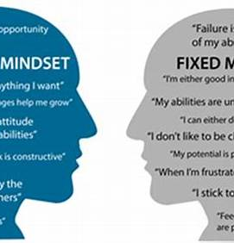

Summary and Key Takeaways
Recap of Main Concepts and Strategies
Importance of Ongoing Commitment and Application
Grit, resilience, and growth mindset empower adults working with children to overcome challenges and improve continuously.
Sustained effort and applying learned principles foster a positive workplace culture and enhance employee performance.

Slide 27


Thank You
https://www.surveymonkey.com/r/6BXBSD5
https://www.surveymonkey.com/r/KFRVQNR

