Slide 2
Grant closeout training
The purpose of today’s training is to share how to close out 5th year grants in the Monitoring system
Notes:
Good Morning! Welcome to the FY2025 Grant Closeout Training sponsored by the Ohio Department of Education and Workforce’s Office of Whole Child Supports.
This session will be recorded and added to the Department’s 21st CCLC webpage early next week.
• We welcome you to share questions and comments in the chat. Members of our Out-if-School Time team will provide responses throughout the training.
• Oral questions will be addressed at the end of the presentation. Please use the “raise hand” feature
and you will be called upon (and unmuted) in order.
• We value your input and ask that you please complete the Feedback Form provided in the chat at the end of the presentation.
Each year, our team conducts the Grant Closeout Training for 5th year grantees to ensure you understand how to successfully closeout your grant.

Slide 3
21st Century Staff & Friends
Office of Whole Child Supports
  Valerie Kunze, Administrator
  Dr. Stacey Brinkley, Grants Manager
  Tiffany Cartier White, Education Program Specialist
  Jacqueline Cheadle, Education Program Specialist
  Sheila Samson, Financial Program Manager
University of Cincinnati Evaluation Services Center
  Dr. Julia Holton, Senior Research Associate
  Center for Out-of-School Advancement
    Chad Heileman, Director
Notes:
Please allow me to introduce you to the Out-of-School Time team!
Valerie Kunze, Administrator
Dr. Stacey Brinkley, Grants Manager
Jacqueline Cheadle, Education Program Specialist, Southeast and Southwest Region Consultant
Tiffany Cartier White, Education Program Specialist, Northeast and Northwest Region Consultant
I am Sheila Samson, the 21st Century Financial Program Manager, representing the Out-of-School Time Team in the Office of Whole Child Supports. I’ll be conducting today’s training, and our entire team is here to answer your questions and support your success to closeout your grant.
Also with us today is Julia Holton, Senior Reseach Associate with University of Cincinnati Evaluation Services Center and Chad Heileman, Director of Center for Out of School Advancement. I will turn it over to Chad.

Slide 4
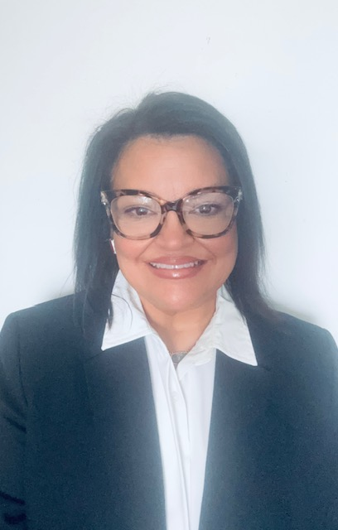
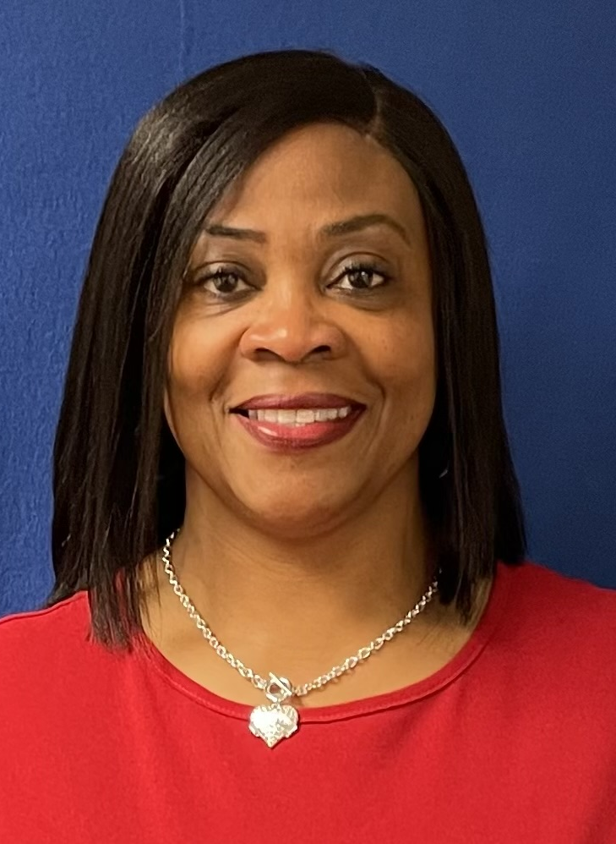

Out of School Time Team
Jacqueline Cheadle
Dr. Stacey Brinkley
Southeast & Southwest Regions
Central Region
Tiffany Cartier-White
Sheila Samson
Northwest & Northeast Regions
Financial Program Manager
Notes:
Just a brief pause so you can put a face to the out of school time team

Slide 5
Presentation Overview
GRANT CLOSEOUT DESK REVIEW
21APR REPORTING
END OF YEAR REPORTING
Notes:
First, we would like to thank you and your staff for devoting the last five years to growing the students in your programs through academic activities, positive youth development and actively involving the families of your students. Although this grant is ending, we hope it was a satisfying experience for you, your staff, your students and families and the communities you have served during this time.
Our goal today is to ensure that you will successfully bring your 21st Century to a close. Throughout the presentation We will refer to the timeline that will help you complete all federally mandated requirements for your grant.
First, we will cover the Grant Closeout Desk Review.
Next, we will discuss reporting the federal data points in the US Department of Education’s 21 APR Data Reporting System.
Lastly, we will share the expectations for the End of Year Reporting

Slide 6
History Log Note
Name
Is this the same person listed as your 21st CCLC Program Manager? If not, have you updated your OEDS information to grant access to DEW systems for final reporting on the grant?
5th year grantees must note in the CCIP history log the name, email address, and telephone number of a person to be considered the primary grant contact after June 30th.
Email Address
Will you have access to this email address through the end of the calendar year for receiving important post-grant communications? If not, have you provided a different address at which we can reach you?
Phone Number
Can you be reached at the phone number provided even after 21st CCLC programming has ended? If not, is there a number at which we can reach you if we have additional questions about your data?
Notes:
It has been our experience that some grantees have contracts with staff and evaluators that end prior the deadlines for reporting required data to the Department. This has resulted in our being unable to contact someone with the data needed to provide the information discussed in this training.
We now require all 5th year grantees make a note in the history log of the CCIP identifying the name, email address, and telephone number of a person our office should consider the primary grant contact after June 30th. This person should then be listed as the 21st CCLC program manager in OEDS to grant them access to our ODE reporting systems and to receive important emails regarding grant closeout requirements. Our suggestion is that this person might be affiliated with your LEA partner and/or that your local evaluator’s contract extend to the end of the calendar year to ensure they can complete these activities for you.
It is a good idea for this person also to follow our blog: https://21stcenturylearningcenters.wordpress.com/

Slide 7

Grant Closeout

Slide 8
Grant Closeout Desk Review
  Review Grant Closeout Guidelines
  Complete Grant Closeout Disposition Form
  Prepare and Run Financial Detailed Reports for Two Fiscal Years
Notes:
There are a few critical components that comprise the Grant Closeout Desk Review:
1 - The Grant Review Closeout Guidelines- ensure expectations are clear to properly and successfully close out the grant.
We will get into the Monitoring System so you’ll know where to find the survey and how to access it to complete the questions and provide the appropriate
Documentation.
2 – Complete the Grant Closeout Disposition Form
3 – Prepare and run financial detailed Reports for two fiscal years.

Slide 9
End of year grant reporting timeline
June 13
Enter History Log Note Indicating Contact for Remaining Grant Responsibilities
September 30
FER Deadline
June 30
End of Fiscal Year
October 3
Grant Closeout Fiscal Review Deadline
Notes:
These are the dates that pertain to the Grant Closeout Desk Review
June 13th - Please provide a History Log Comment in the CCIP to indicate who your grant program contact will be for all closeout responsibilities
June 30th – this is the end of the fiscal year. We encourage you to get your PCRs in ASAP so those can be processed. It would be IDEAL to get your PCRs submitted by Wednesday June 11th at noon, to avoid the State Accounting System’s two-week shutdown. When the system reopens on July 1st, be mindful that there will be lots of PCRs that need to be processed – the sooner you get your PCRs in to be processed and paid, the better.
September 30th – Please make sure to submit your Final Expenditure Report in the CCIP by this date! I advise you not to wait until this date to submit – in past years we’ve had some grantees wait until the last minute and run into issues trying to enter data, due to incorrect roles in OEDS or general system glitches. Many things can happen so please be mindful and work on submitting these well in advance of 9/30

Slide 10

Grant Closeout
Guidelines
21st Century Community Learning Center (CCLC) Grant Closeout Guidelines
21st-cclc-grant-closing-guidelines.pdf
uniform_school_accounting_system_user_manual
Notes:
You can use the link to reference the 21st CCLC Grant Closeout Guidelines.
REMINDER: As previously provided in the Request for Proposal and during the orientation, you must use the State’s Uniform School Accounting System (USAS) when budgeting and coding expenses. The link to the USAS Manual is provided for your convenience. It was previously recommended you work with your treasurer/Certified Public Accountant/Fiscal Representative to ensure proper coding to prevent a findings during a fiscal review.
Keep in mind, this is a competitive grant so your awarded budget should be entered into the CCIP with minor revisions. You must spend according to your approved CCIP budget and narrative.

Slide 11

Accessing THE Monitoring System
REQUIRED ROLES
Program Manager – 21st Century Grant;
Data Entry - Compliance; or
Data Entry - 21st Century (21APR)

Slide 12
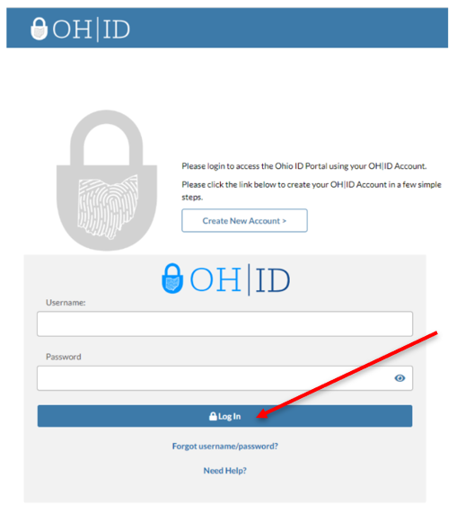
Entering the Monitoring Application
Go to https://ohid.ohio.gov to log into your OH|ID account.
Notes:
I am gong to share a general overview of how to navigate the Monitoring Application.
Please note: the system is currently not accessible for grantees, a reminder will go out – once this happens.
Step 1…

Slide 13
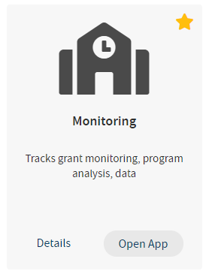
Entering the Monitoring Application
Under My Sites & Applications, find and click on the Monitoring application

Slide 14
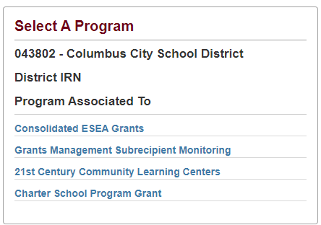
Entering the Monitoring Application
From the Monitoring Dashboard, ensure you have access to the correct program. Click on 21st Century Community Learning Centers

Slide 15
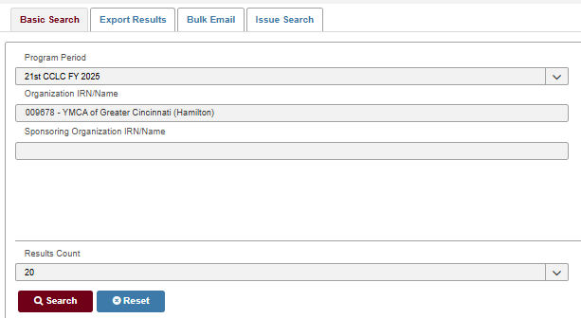
Entering the Monitoring Application
Under Basic Search, type in your District/Organization name (if not auto populated) then click SEARCH
  Be sure that the Program Period is in FY2025

Slide 16
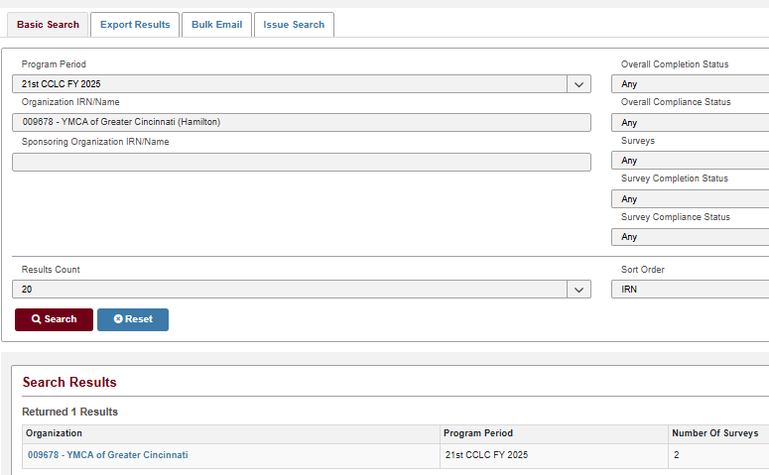
Entering the Monitoring Application
Under Search Results, click your District/Organization name listed under Organization

Slide 17
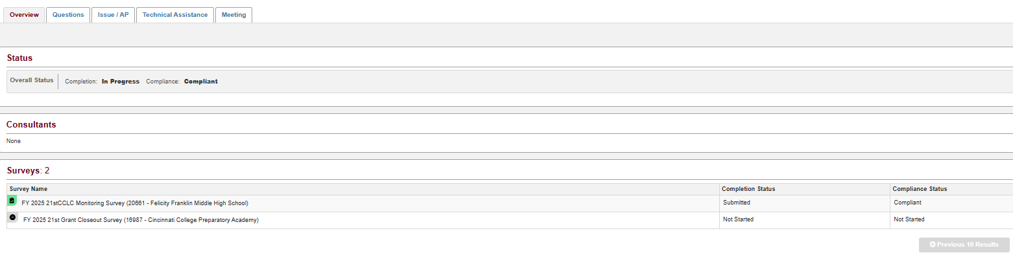
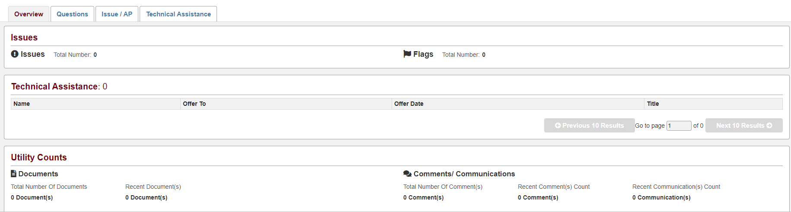
Entering the Monitoring Application
Review the Overview Tab for the following: Survey Status, Number of Surveys, Issues (CAPs), Technical Assistance (TAs), and Utility Counts (Documents, Comments/Communications). Confirm information here is correct.
Notes:
dashboard

Slide 18
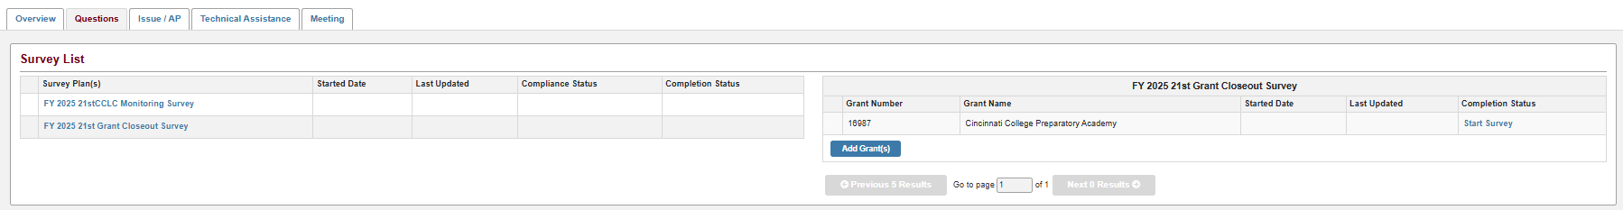
Grant Closeout FY25 Survey
Click on the Questions Tab
Go to Grant Closeout Survey
Click Start Survey
Notes:
You will see Start Survey
All sub-grantees are required to know and are held accountable to the rules and regulations that govern the 21st Century grant:
CCIP Assurances (Specifically RECORDS RETENTION) 3yrs
U.S. DOE Federal Guidelines
http://www.ed.gov/programs/21stcclc/index.html
U.S. DOE Non-Regulatory Guidance
http://www.ed.gov/programs/21stcclc/guidance2003.doc
EDGAR (Education Department General Administrative Regulations)
http://www.ed.gov/policy/fund/reg/edgarReg/edgar.html
OMB Circulars
- Ohio Revised Code & Ohio Administrative Code
- State Guidelines

Slide 19
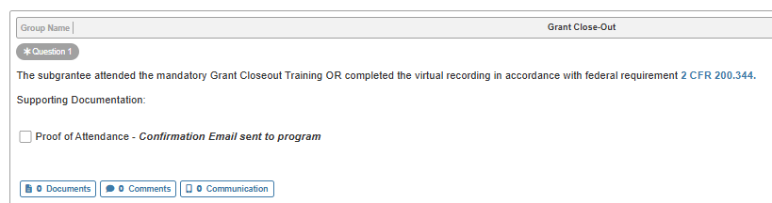
Grant Closeout Survey – Question 1
Upload Evidence for each question
Notes:
All 5th year grantees are REQUIRED to take part in this training to ensure their grant is closed out properly. Your attendance at today’s training will be acknowledged by a confirmation email. At the end of this presentation, we will provide a link to sign in for attendance and we will also compare all sign ins with the generated Zoom attendance. Please be sure to upload the email when you receive it. Click on the Documents tab and follow the instructions to upload it.
All sub-grantees are required to know and are held accountable to the rules and regulations that govern the 21st Century grant:
CCIP Assurances (Specifically RECORDS RETENTION) 3yrs
U.S. DOE Federal Guidelines
http://www.ed.gov/programs/21stcclc/index.html
U.S. DOE Non-Regulatory Guidance
http://www.ed.gov/programs/21stcclc/guidance2003.doc
EDGAR (Education Department General Administrative Regulations)
http://www.ed.gov/policy/fund/reg/edgarReg/edgar.html
OMB Circulars
- Ohio Revised Code & Ohio Administrative Code
- State Guidelines

Slide 20
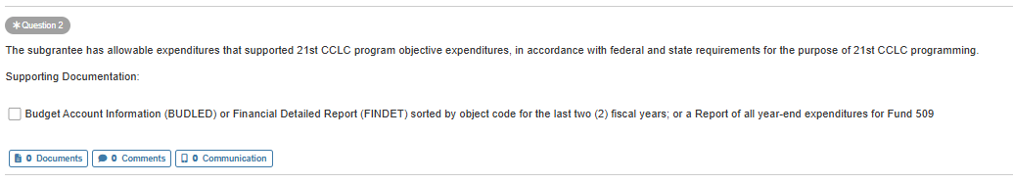
Grant Closeout Survey – Question 2
Notes:
We want to see your fiscal year to date expenditures by Fiscal Year to Date Expenditures with Fund, Function Code and Object Code.
Detailed financial reports should be sorted and totaled by object and contain function code. The financial report must show details such as vendor name, description of expense, date paid, amount paid, etc.

Slide 21
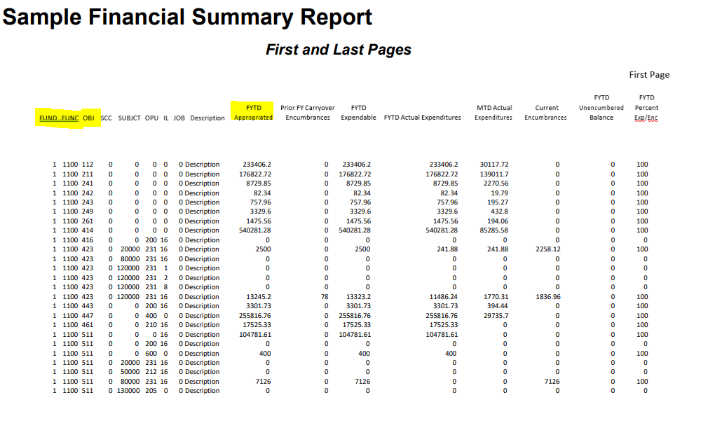
Financial Detailed Report of Actual Expenditures by Object Code
(Last 2 years)
Notes:
Here’s an example of a Financial Report that would be acceptable to submit as documentation

Slide 22
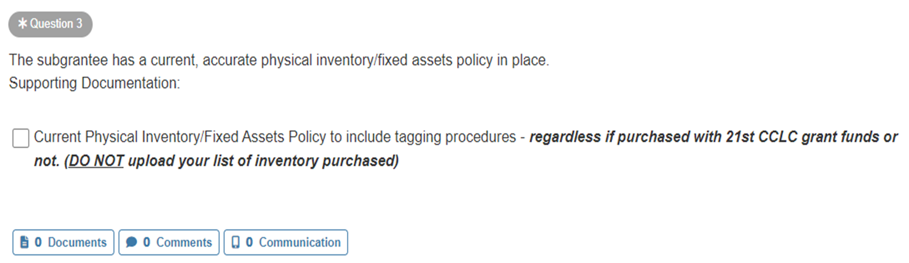
Grant Closeout Survey – question 3
Provide local policy NOT list of Inventory
Notes:
Ensure your policy includes tagging procedures

Slide 23
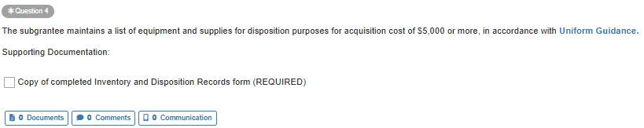
Grant Closeout Survey – Question 4
Upload completed Disposition Form
21st Century Community Learning Centers Inventory Disposition Request Form 2024.pdf
Notes:
Will add the 2025 Disposition Form

Slide 24
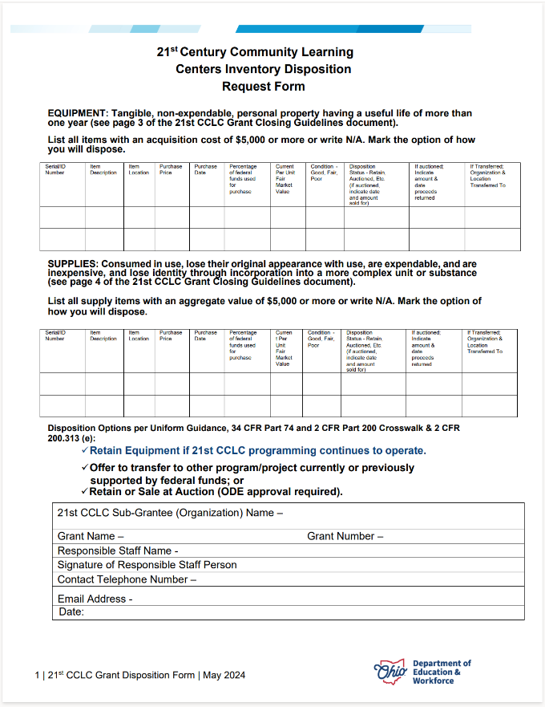
Disposition Form
21st Century Community Learning Centers Inventory Disposition Request Form 2024.pdf
Notes:
Add link

Slide 25
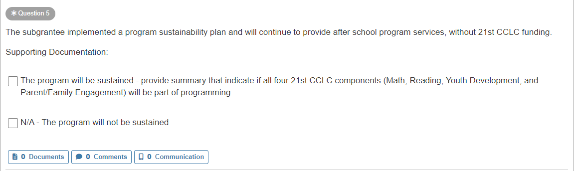
Grant Closeout Survey – question 5
Will the 21st Century Program be Sustained?
Notes:
Remember that sustainability is very important. We have never been able to guarantee funding and we want you to be able to continue to provide this important program to our students.

Slide 26
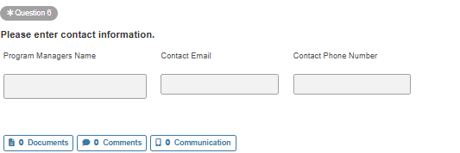
Grant Closeout Survey – question 6

Slide 27

Grant Closeout - Whom to Notify
Staff/Parent/Families/Student Participants
Community Partners
Non-public Schools in the Area
Governing Authority Board(s)
Advisory Groups & Other Stakeholders
Notes:
Be sure to:
Close out all contracts
Take appropriate action on
- Pending Invoices
- Uncashed Checks
- Bank Accounts
- Regarding Your Facility
Collect & void all unused checks
Plan A-133 Single Audit
Conduct a Final Evaluation & prepare a Summary
Update OEDS
Complete revision requests
Update Website

Slide 28
Monitoring Survey &
Grants Management Resources
Grants Manual https://education.ohio.gov/getattachment/Topics/Finance-and-Funding/Grants-Administration/Managing-Your-Grant/Managing-Your-Grant.pdf.aspx?lang=en-US
Quick Reference Guide Grants-Management-Quick-Reference-Guide-Manual.pdf.aspx
Managing Your Grant https://education.ohio.gov/Topics/Finance-and-Funding/Grants-Administration/Managing-Your-Grant

Slide 29
UNIFORM GUIDANCE
34 CFR Part 80 Subpart C 80.32 & 80.33, and Subpart D 80.50 (https://www.govinfo.gov/content/pkg/CFR-2014-title34-vol1/pdf/CFR-2014-title34-vol1-part80.pdf)
2 CFR 200.344 (https://www.ecfr.gov/current/title-2/subtitle-A/chapter-II/part-200/subpart-D/subject-group-ECFR682eb6fbfabcde2/section-200.344)
Uniform Guidance Crosswalk (https://www2.ed.gov/policy/fund/guid/uniform-guidance/crosswalkbtw3474.pdf)
Notes:
NOW TIFFANY WILL COVER 21APR REPORTING

Slide 30
21APR REPORTING
Notes:
TIFFANY
Hello everyone, I’m Tiffany Cartier White – Education Program Specialist for the NW and NE region and I facilitate the reporting of 21 APR data. I also manage our office’s communications via GovDelivery and the 21st Century’s webpages where you will find critical program updates and resources shared should you need additional help.

Slide 31
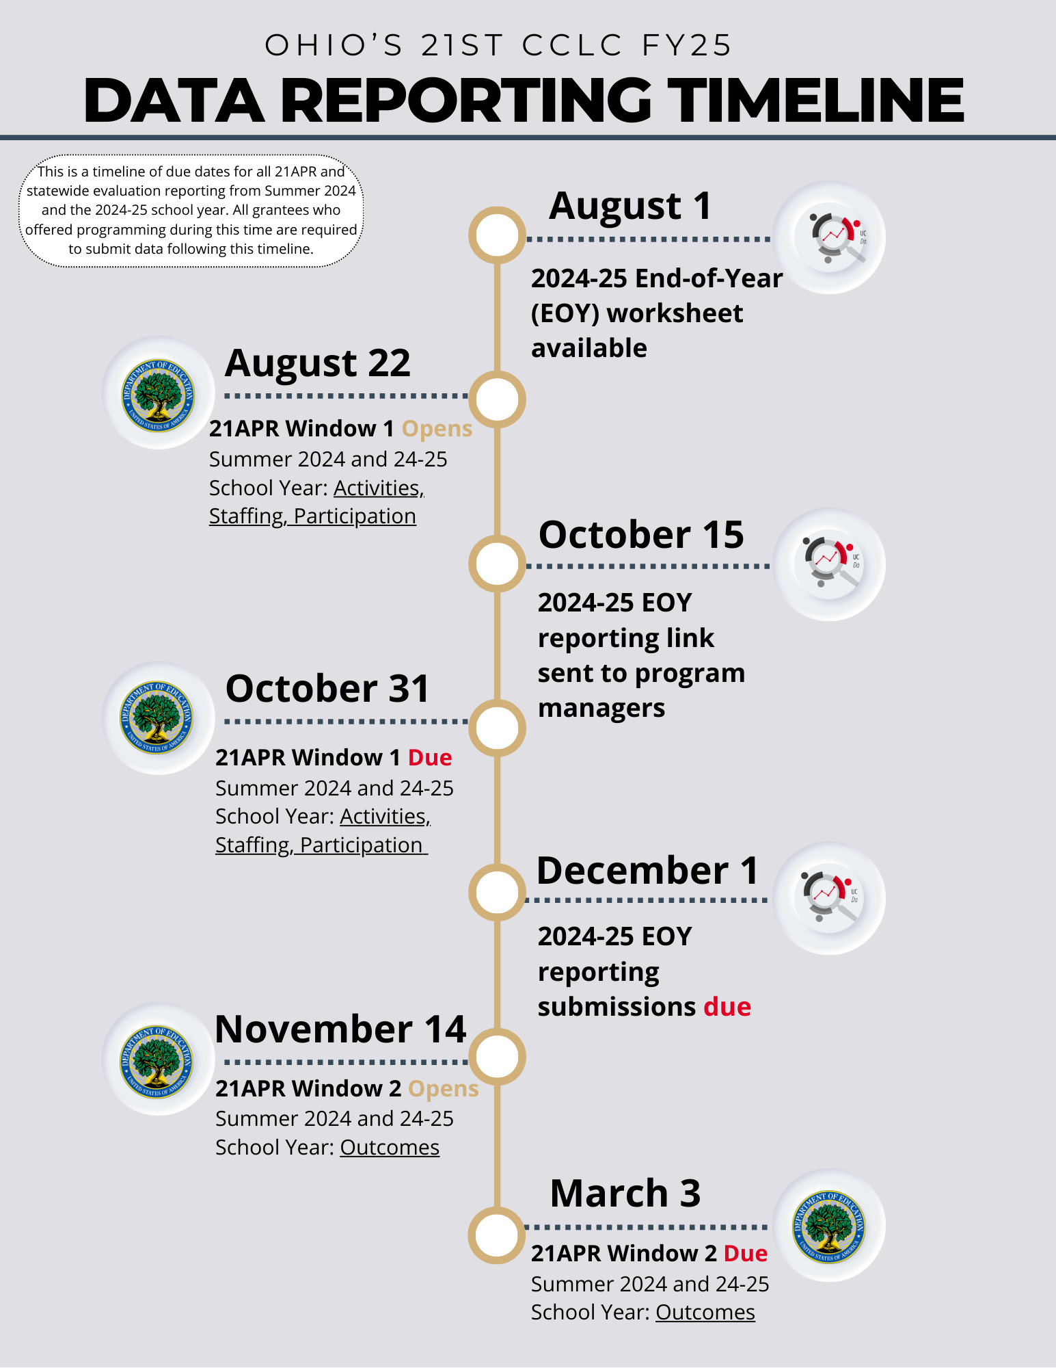
Notes:
TIFFANY
We'll share this timeline throughout the training – take a look at the highlighted area above...you’ll see the reporting windows for 21APR data.
You'll report data in DEW’s internal OH-ID portal. Your Program Manager will receive notifications for trainings and the availability of instructional resources via GovDelivery.
These resources will also be shared on the 21st CCLC webpage.

Slide 32
21APR Reporting Requirements
School Year 1*
Summer
School Year 2
Summer
School Year 3
Summer
School Year 4
Summer
School Year 5
Reported During SU/SY2
Reported During SU/SY3
Reported During SU/SY4
Reported During SU/SY5
Reported Closeout SU
Notes:
TIFFANY
The federal grant year and the state fiscal years do not align – We created this chart to review the reporting schedule for 21APR data.
During these final reporting windows you will report your data for the summer before this school year that is about to end and this most recent school year.
If your sites did not have summer programming, you'll indicate this when you report your data, by marking the summer site center as inactive.

Slide 33
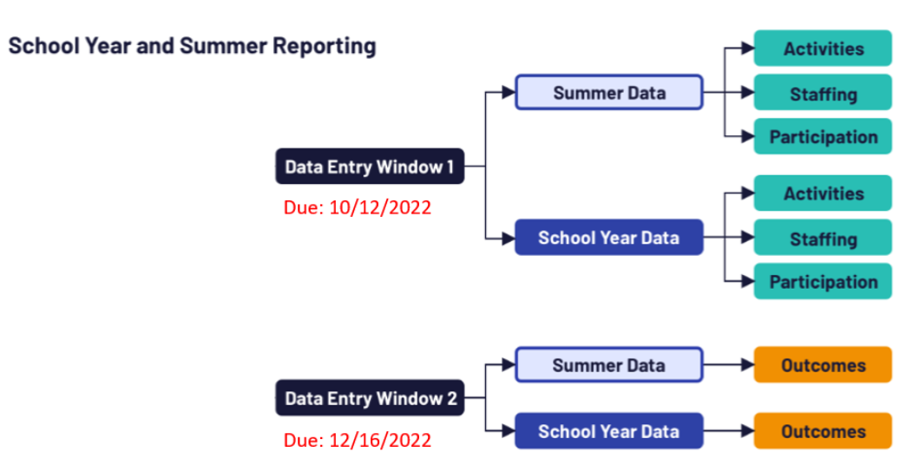
21APR Reporting Windows
Data Entry Window #1
August 22, 2025 – October 31, 2025
Activities
Staffing
Participation
Notes:
TIFFANY
The first window will be for reporting your activities, staffing and participation data – we anticipate this window will open in late August and we plan to give grantees around a month to complete their data entry.
Note there are two separate surveys – one for summer term and one for the school year. You'll need to open each grant site to complete the in the system.

Slide 34
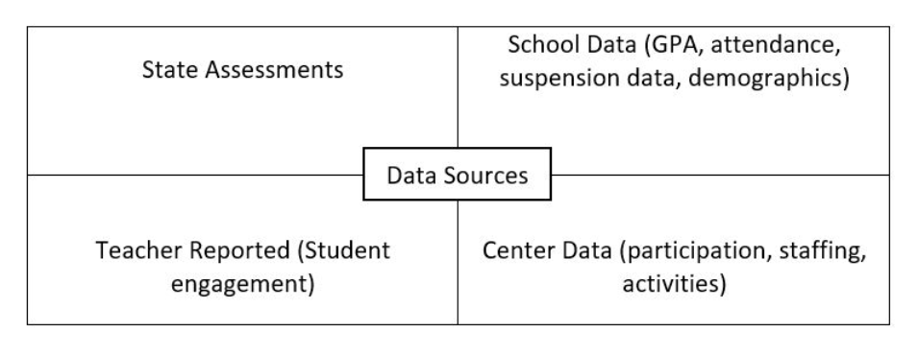
Data Inventory
Notes:
TIFFANY
As you close out your grants, don’t forget the data needed for your final reporting requirements and from whom you must get them:
Activities: types/amount offered
Staffing: staff number and paid/unpaid status
Participation: program attendance, student demographics
Outcomes:
GPRA#1: state assessment data
GPRA#2: grade point averages
GPRA#3: school day attendance
GPRA#4: in-school suspension data (if applicable)
GPRA#5: student engagement survey (for teachers – see next slide)
Make sure your program contact for communications has access to this information for activities on the timeline shared throughout this training.

Slide 35
21APR Reporting Windows
Data Entry Window #2
November 14, 2025 –
March 3, 2026
Outcomes
Notes:
TIFFANY
The second window will be for reporting your outcomes data – we anticipate this window will open in mid November and we plan to give grantees around about 2 months to complete their data entry.
Note (again) there are two separate surveys – one for summer term and one for the school year. You will complete the survey for each grant site listed in the system (if you previously marked a site inactive during the first reporting window, you will have no data to enter for that site).

Slide 36
Reminder:
GPRA #5 (part of the Outcomes reporting survey) asks the teacher of record for 21st CCLC participants in grades 1-5 to report on classroom engagement for the summer and school year terms (summer of 2024 and the 24-25 school year).
This simple survey should be completed by those teachers before 2024-2025 school year programming ends and given to the 21st CCLC program manager to ensure the data is available later this fall.
GPRA #5
Outcomes Reporting (November)
Grades 1-5 Only
Summer & School Year Terms
Survey Link
Notes:
TIFFANY
As a reminder, you'll reference the teacher survey provided on 21st Century's Evaluation Resources webpage (place link in chat) for window 2s Outcomes question concerning teacher-reported classroom engagement.
This survey is regarding the school year ending now (and the previous summer), so it is easiest for teachers to complete right now while the information is still fresh in their memories. Be sure results are compiled and kept for the staff person reporting your data in November. It's difficult to get a good survey response rate from teachers if you wait until the fall to administer this survey.
Next: The University of Cincinnati will now share their end-of-year reporting requirements with you.

Slide 37

STATEWIDE EVALUATION
Notes:
JULIA

Slide 39
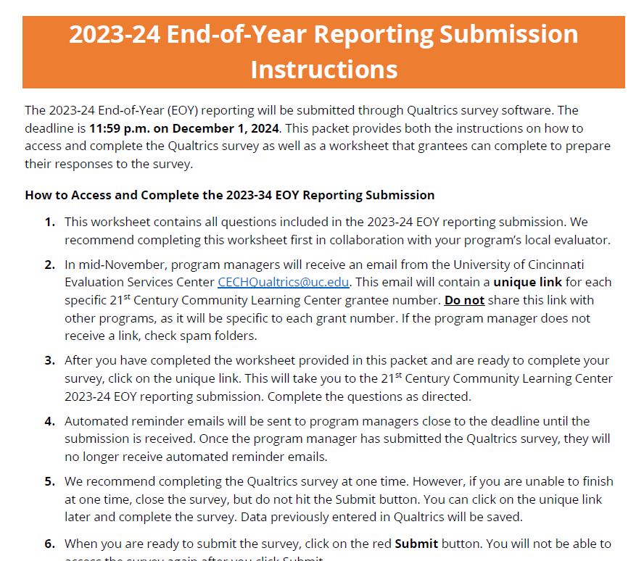
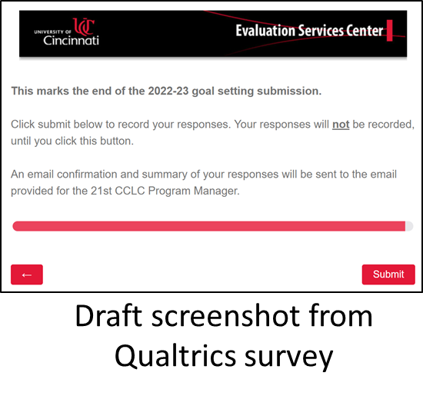
Statewide Evaluation End of year reporting to UCESC
Worksheet will be available in August
Similar to End-of-Year reporting from 2023-24
Qualtrics links will be sent to program managers in October
Final End-of-Year data due in December

Slide 40
Statewide Evaluation Questions for UCESC?
Questions can be submitted via this link: https://bit.ly/21stCCLCEvalQs 24-25 Statewide Evaluation FAQ
Please continue to check the 2024-25 Evaluation Resources: Evaluation Resources | Ohio Department of Education and Workforce

Slide 41
Key Dates for Grant Closeout
June 13, 2025 - Enter History Log Note in CCIP Indicating Contact for Remaining Grant Responsibilities
September 30, 2025 – Final Expenditure Report (FER) Deadline
October 4, 2025 - Grant Closeout Fiscal Review Deadline
October 31, 2025 – 21APR Staffing and Participation Data Due
December 1, 2025 – EOY Statewide Evaluation Reporting Due
March 6, 2026 – 21APR Outcome Data Due
Notes:
SHEILA
Remind grantees of key dates

Slide 42
Notes:
SHEILA

Slide 43
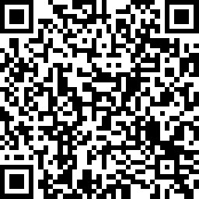
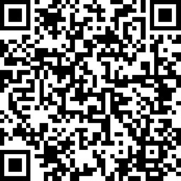
Make sure you sign in…And tell us what you think!
Attendance Survey Link:
https://www.surveymonkey.com/r/HPS5KY8
Satisfaction Survey Link:
https://www.surveymonkey.com/r/HPNMFPW
Notes:
update

