Slide 1


Program Sustainability
Presented by: H. Michelle Toney,
Southwest Regional COSA Specialist
April 22nd – April 26th 2025

Slide 2

Ground Rule
Engage - Engagement benefits everyone participating in the discussion. It is essential that we take the opportunity to learn from one another.
If possible, please keep the cameras on.

Slide 3

Agenda
Welcome
Training Objective
Ice Breaker
Thinking Broadly and Strategic Planning
Collaboration for Financial Sustainability
Program Evaluation and Adaptability
Communications
Funding Stability
Sustainability Practices

Slide 4
Training Objective
This training is designed to help non-profit afterschool programs grasp the essentials of achieving long-term sustainability. Attendees will be guided through various strategies that are crucial for the ongoing success of their initiatives.
The session will emphasize the identification of critical actions that can be implemented to secure ongoing support and foster growth. By participating, program leaders will acquire important knowledge and tools to effectively steer their programs toward a sustainable future.
Although there is no universal solution, achieving sustainability is not only possible but vital for the important services programs offer to the community.

Slide 5
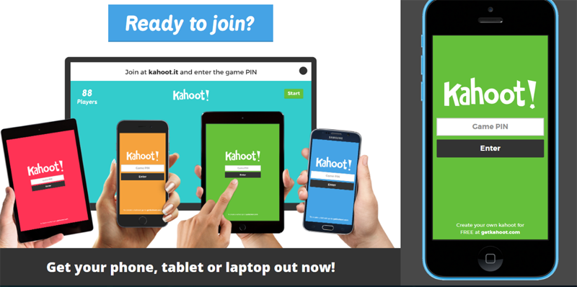
Sustainability Practices Kahoot – Ice Breaker
Game PIN:
1525058
Please use your phone to log on to Kahoot.it
Notes:
Fun interactive game that gives participants the opportunity to answer questions on sustainability.

Slide 6
Sustainability
Everyone wants it; everyone sees it differently.
More often than not, sustainability is thought to mean raising money. But money is only part of the equation. You can’t raise money without having a quality program, and you can’t prove you have a quality program unless you can show results, and you can’t show effective results unless you have good management practices…and so it goes. Sustainability, therefore, is many things that in combination make something capable of lasting over time.
A truly sustainable afterschool program has an array of community supporters and partners who are critical to assessing kids’ needs and discovering community resources.

Slide 7

Thinking Broadly
Typically, when we think about sustainability, we focus only on funding.
What sustains a program goes beyond funding AND funding is often affected by other factors
Notes:
When we think about sustainability, we frequently focus primarily on financial backing.
This limited viewpoint can hinder our comprehension of the wider effects and actions that play a crucial role in fostering sustainable development.
The longevity of a program relies on more than just financial support; in fact, funding itself can be influenced by a variety of external elements. These factors can include community engagement, stakeholder involvement, and the overall effectiveness of the program, all of which play a crucial role in ensuring its continued success and viability.
Moreover, while securing adequate funding is essential, it is equally important to recognize that a program's sustainability is intertwined with its ability to adapt and respond to changing circumstances. This adaptability can help maintain interest and support from both the community and potential investors, ultimately contributing to the program's enduring impact.

Slide 8
Connectivity
Strategic Planning
Funding Stability
Partnerships
Organizational Capacity
Program Evaluation
Program Adaptation
Communications

Slide 9
Strategic Planning
Implementing structured processes that steer the direction, objectives, and strategies of your program is essential for achieving success. These guiding frameworks help ensure that every aspect of your program aligns with its overall vision, making it easier to track progress and make informed decisions along the way.
By establishing clear processes, you create a roadmap that not only defines where you want to go but also outlines how to get there. This approach fosters a cohesive environment where team members understand their roles and responsibilities, ultimately leading to more effective collaboration and better outcomes for the program.
Notes:
Establishing well-defined processes that guide the goals, direction, and strategies of your program is crucial for attaining success. These foundational frameworks play a vital role in ensuring that all elements of your program are in harmony with its overarching vision, facilitating the monitoring of progress and enabling informed decision-making throughout the journey.
By creating a structured approach, you not only clarify the objectives but also enhance the ability to adapt and respond to challenges as they arise. This alignment allows for a more cohesive effort, ensuring that every action taken contributes meaningfully to the program's success and helps maintain focus on the desired outcomes.

Slide 10
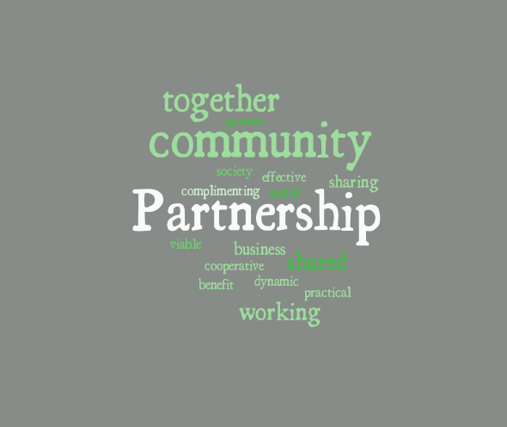
Collaborating for Financial Sustainability - Partnerships
Collaboration is essential for nonprofits, as it help in achieving goals and improving financial sustainability. Through strong partnerships, organizations can reduce costs, increase effectiveness, and leverage resources that are vital for success.
Notes:
Nonprofit organizations greatly benefit from collaboration, as it plays a crucial role in reaching their objectives and enhancing their financial stability. By forming robust partnerships, these organizations can lower expenses, boost their operational efficiency, and tap into essential resources that contribute to their overall success.
Working together allows nonprofits to share knowledge and expertise, creating a more impactful approach to their missions. This synergy not only fosters innovation but also enables organizations to maximize their reach and effectiveness, ultimately leading to a more sustainable future for their initiatives.

Slide 11
Steps to collaboration
Identify common goals – we can collaborate with other organizations that share common mission and vison.
Leverage skills and expertise – collaborate with businesses and other organizations to leverage skills and expertise.
Share resources – this allows the opportunity to share resources, which can reduce costs and increase efficiency.
Build trust – building strong partnerships requires trust between the
organizations involved.
Notes:
Recognizing shared objectives is essential for fostering collaboration with other organizations that align with our mission and vision. By identifying these common goals, we can work together more effectively, creating a unified approach that enhances our impact and drives us toward mutual success.
Utilizing the diverse skills and expertise of various businesses and organizations can significantly enhance our collaborative efforts. By pooling our resources, we not only reduce costs but also improve overall efficiency. Furthermore, establishing strong partnerships hinges on cultivating trust among the involved organizations, which is vital for ensuring a productive and harmonious working relationship.

Slide 12

Program Evaluation
Evaluating your program to guide future planning and record outcomes is essential. This process helps in understanding the effectiveness of your initiatives and provides valuable insights for improvement.
Notes:
Assessing your program is crucial for informing future strategies and documenting results. This evaluation process not only sheds light on how well your initiatives are performing but also offers important insights that can drive enhancements and refinements.
By taking the time to analyze the outcomes of your efforts, you can gain a clearer picture of what works and what doesn’t. This understanding is vital for making informed decisions that will lead to more effective programs in the future.

Slide 13

Program Adaptability
Adjusting your strategies to maintain consistent effectiveness is essential. Proactively modifying your approach will help you achieve sustained results.
Notes:
1. It is crucial to adapt your strategies in order to ensure ongoing effectiveness. By actively refining your methods, you can secure lasting outcomes that meet your goals.
2. Staying effective requires a willingness to adjust your strategies regularly. By taking the initiative to change your approach when necessary, you can achieve results that are not only consistent but also enduring.

Slide 14

Communications
Effectively sharing information about your programs and services with your partners and the public.
It’s essential to build strong communication channels with your partners and the community regarding what you offer.
Notes:
Successfully conveying details about your programs and services to both your partners and the general public is crucial. Establishing robust communication pathways with your collaborators and the community is vital for ensuring that everyone is well-informed about what you provide.
It is important to foster effective communication with your partners and the wider community to share information about your offerings. By creating strong channels of dialogue, you can ensure that your audience is fully aware of the programs and services available, enhancing engagement and collaboration.

Slide 15

Leverage Technology
Online fundraising platforms
Social Media
Notes:
Many of us have a platform linked to our websites, yet we often overlook the importance of promoting this feature.
Social media serves as a powerful platform for promoting your brand to a wider audience. It offers the unique advantage of connecting with individuals beyond your immediate geographical location. By actively engaging on platforms such as Instagram, Facebook, TikTok, and Twitter, you can effectively enhance your brand's visibility and reach diverse demographics.

Slide 16

Funding Stability
Create a stable financial foundation for your program.
Secure multiple avenues of funding.
Notes:
Establishing a solid financial base for your program, while also broadening your funding sources, is essential for achieving lasting success. This strategy not only provides dependable financial backing but also reduces the risks that come with relying on just one source of funding.
Exploring various sources of funding strengthens the program's ability to withstand and adjust to changing economic circumstances, ensuring its continued success. A comprehensive financial approach not only promotes sustainability but also opens doors to innovative projects that resonate with the objectives of your program.

Slide 17

Understanding the Importance of Financial Sustainability in Nonprofits
Financial sustainability is a crucial aspect of nonprofit organizations, as it enables the nonprofit the ability to carry out its missions effectively and efficiently.
It involves the ability to generate revenue and manage expenses in a way that ensures the long-term viability of our organizations.
Financial sustainability is not only essential to the survival of nonprofits but also to our ability to grow and have a greater impact on our communities.
Notes:
Financial sustainability plays a vital role in the success of nonprofit organizations, as it empowers them to fulfill their missions both effectively and efficiently. This concept encompasses the capacity to generate income while managing expenditures in a manner that secures the long-term health and stability of the organization.
Moreover, financial sustainability is not just about ensuring the survival of nonprofits; it is also about fostering growth and enhancing the positive influence they can have on their communities. By maintaining a solid financial foundation, nonprofits can expand their reach, innovate their programs, and ultimately create a more significant impact in the lives of those they serve.

Slide 18
21st CCLC PROGRAM Sustainability Plan - Example
OBJECTIVE | WHO? | BY WHEN? | BENCHMARK | PROGRESS?
Increase community partners and community contributors | Program Coordinator / Staff | ONGOING | Number of Community partners and contributors
Explore ODJFS Child Care Assistance Program for qualifying families | Program Coordinator /Fiscal Administrators | ONGOING | Qualification of Families for Child Care Assistance
Develop fee scale for families whose children want to participate but do not qualify under current program criteria | Program Coordinator /Fiscal Administrators | ONGOING | Fee Scale created based on actual program cost per student
Pursue use of blending funds from Title I, Title II, Title III, and other sources. | Program Coordinator/ District Grant Manager/ Fiscal Administrators | ONGOING | Utilization of blended funds to support program components
Explore other potential sources of funding. | Program Coordinator/ District Grant Manager/ Fiscal Administrators | ONGOING | Identification of funders and funding resources
Advocate for extended funding 21st CCLC grants to partially support sustainability and continued focus on academic intervention | Program Coordinator/ District Grant Manager/ District and Fiscal Administrators | ONGOING | Funding is provided by non-compete application
INTENDED OUTCOME: Achieve sustainability beyond duration of 21st CCLC grant funding
Sustainability Plan | TARGET DATE OF COMPLETION:

Slide 19
Sustainability Practices
A well developed fundraising strategy will help organizations raise the funds that are needed to continue to operate programs, grow programs and support the mission.
Develop a donor engagement plan
a. Strategies for acquiring new donors
b. Retaining current donors
c. Re-engaging lapsed donors
It is essential to understand the motivations and interests of donors to tailor engagement efforts effectively
Notes:
A thoughtfully crafted fundraising strategy is essential for organizations seeking to secure the financial resources necessary to sustain their programs, expand their initiatives, and further their mission. By implementing a comprehensive approach to fundraising, organizations can effectively engage donors, build lasting relationships, and ensure that they have the funds required to thrive and make a meaningful impact in their communities.
A robust fundraising plan not only focuses on immediate financial needs but also lays the groundwork for future growth and sustainability. It enables organizations to identify diverse funding sources, tailor their messaging to resonate with potential supporters, and create a compelling case for support. This strategic alignment not only enhances the organization’s ability to meet its current goals but also positions it for long-term success in fulfilling its mission.

Slide 20
Sustainability Practices
Diversify funding sources – Relying too heavily on a single funding source can leave organizations vulnerable if that source dries up (21st Century, ESSER, etc.) Diversifying funding sources can help mitigate this risk.
a. State/County Grants
b. Federal Grants
c. Private Grants
d. Individual Donors
e. Corporations
f. Vouchers
g. Private pay
h. Volunteers
j. Braiding grants
k. Board Development
l. Fundraising – Gala/Fish Fry's/Golf Outing
J. Create a network map
Notes:
Organizations should consider broadening their funding sources, as depending solely on one can create significant risks if that source becomes unavailable, such as with programs like the 21st Century or ESSER. By diversifying their funding streams, organizations can reduce their vulnerability and ensure a more stable financial foundation, allowing them to continue their operations and initiatives even in challenging circumstances.
Exploring various funding avenues not only enhances financial security but also opens up new opportunities for growth and innovation. This approach encourages organizations to seek out grants, partnerships, and alternative revenue streams, ultimately fostering resilience and sustainability in their mission-driven work.

Slide 21
Finding Funding Worksheet
One of the steps to finding funding to sustain your afterschool program is to identify and pursue a diverse blend of funding sources. Use this worksheet to brainstorm the various sources of funding that you use or could use to sustain your program.
Federal | State | Local | Private | In-Kind
Page 25 of workbook

Slide 22

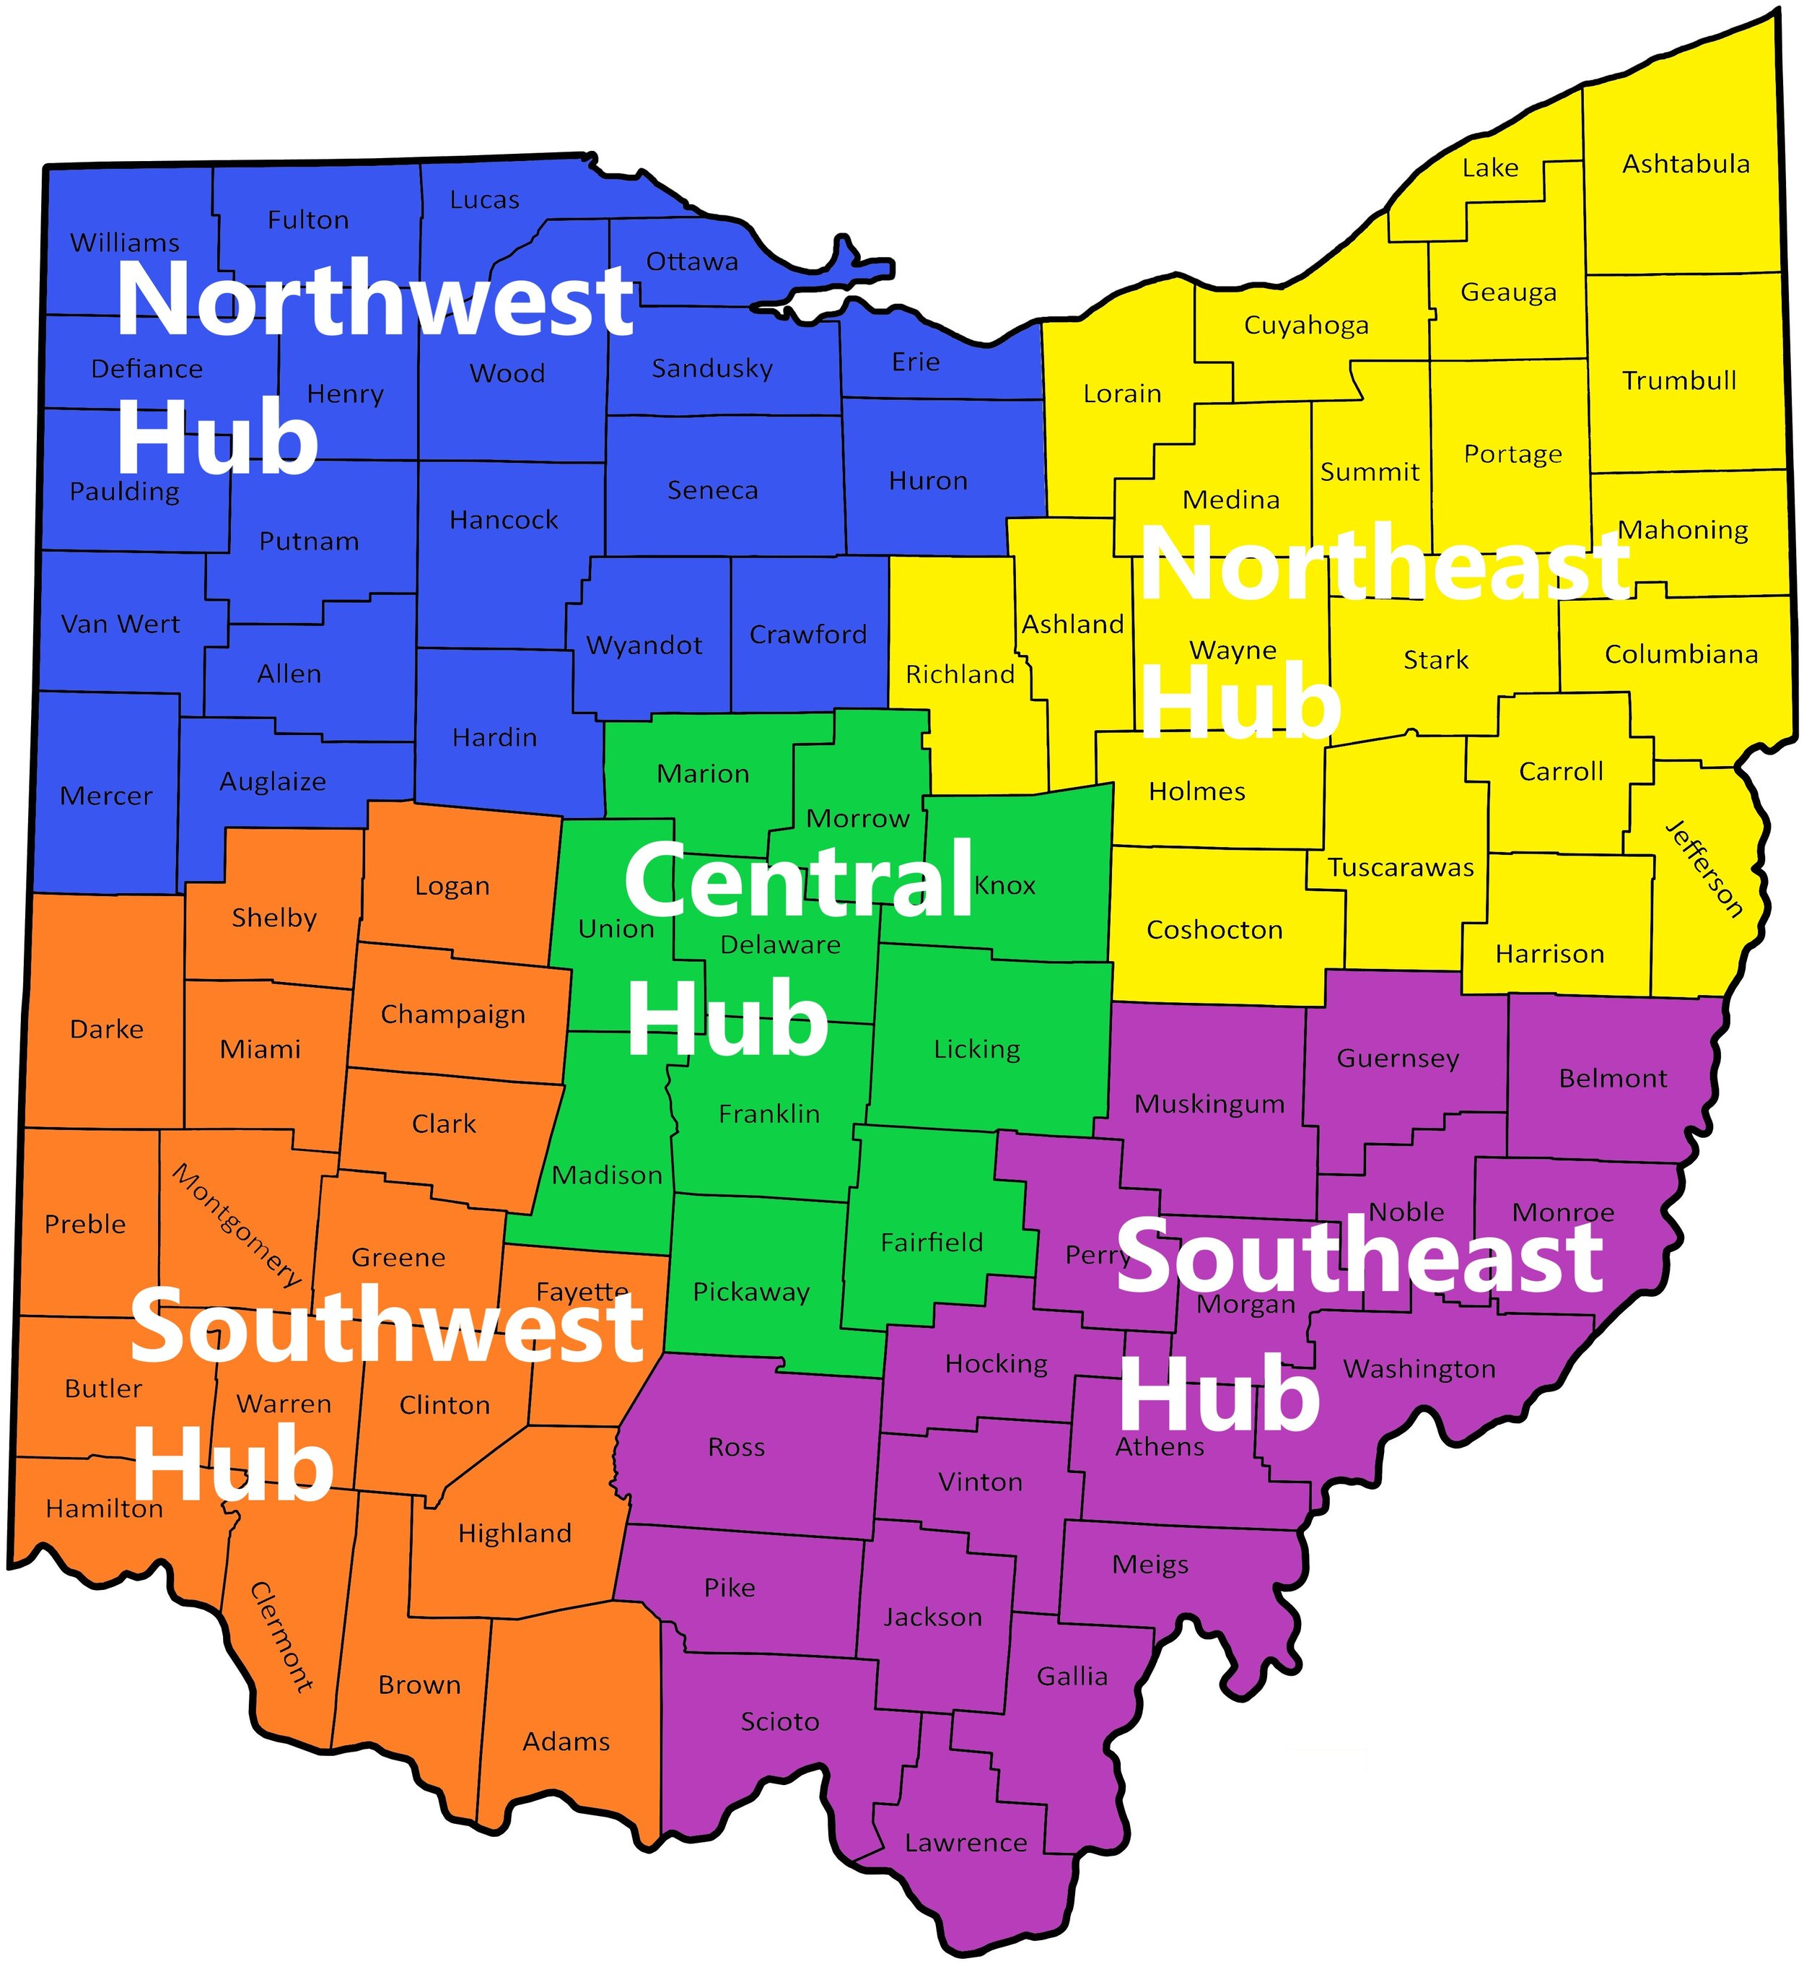

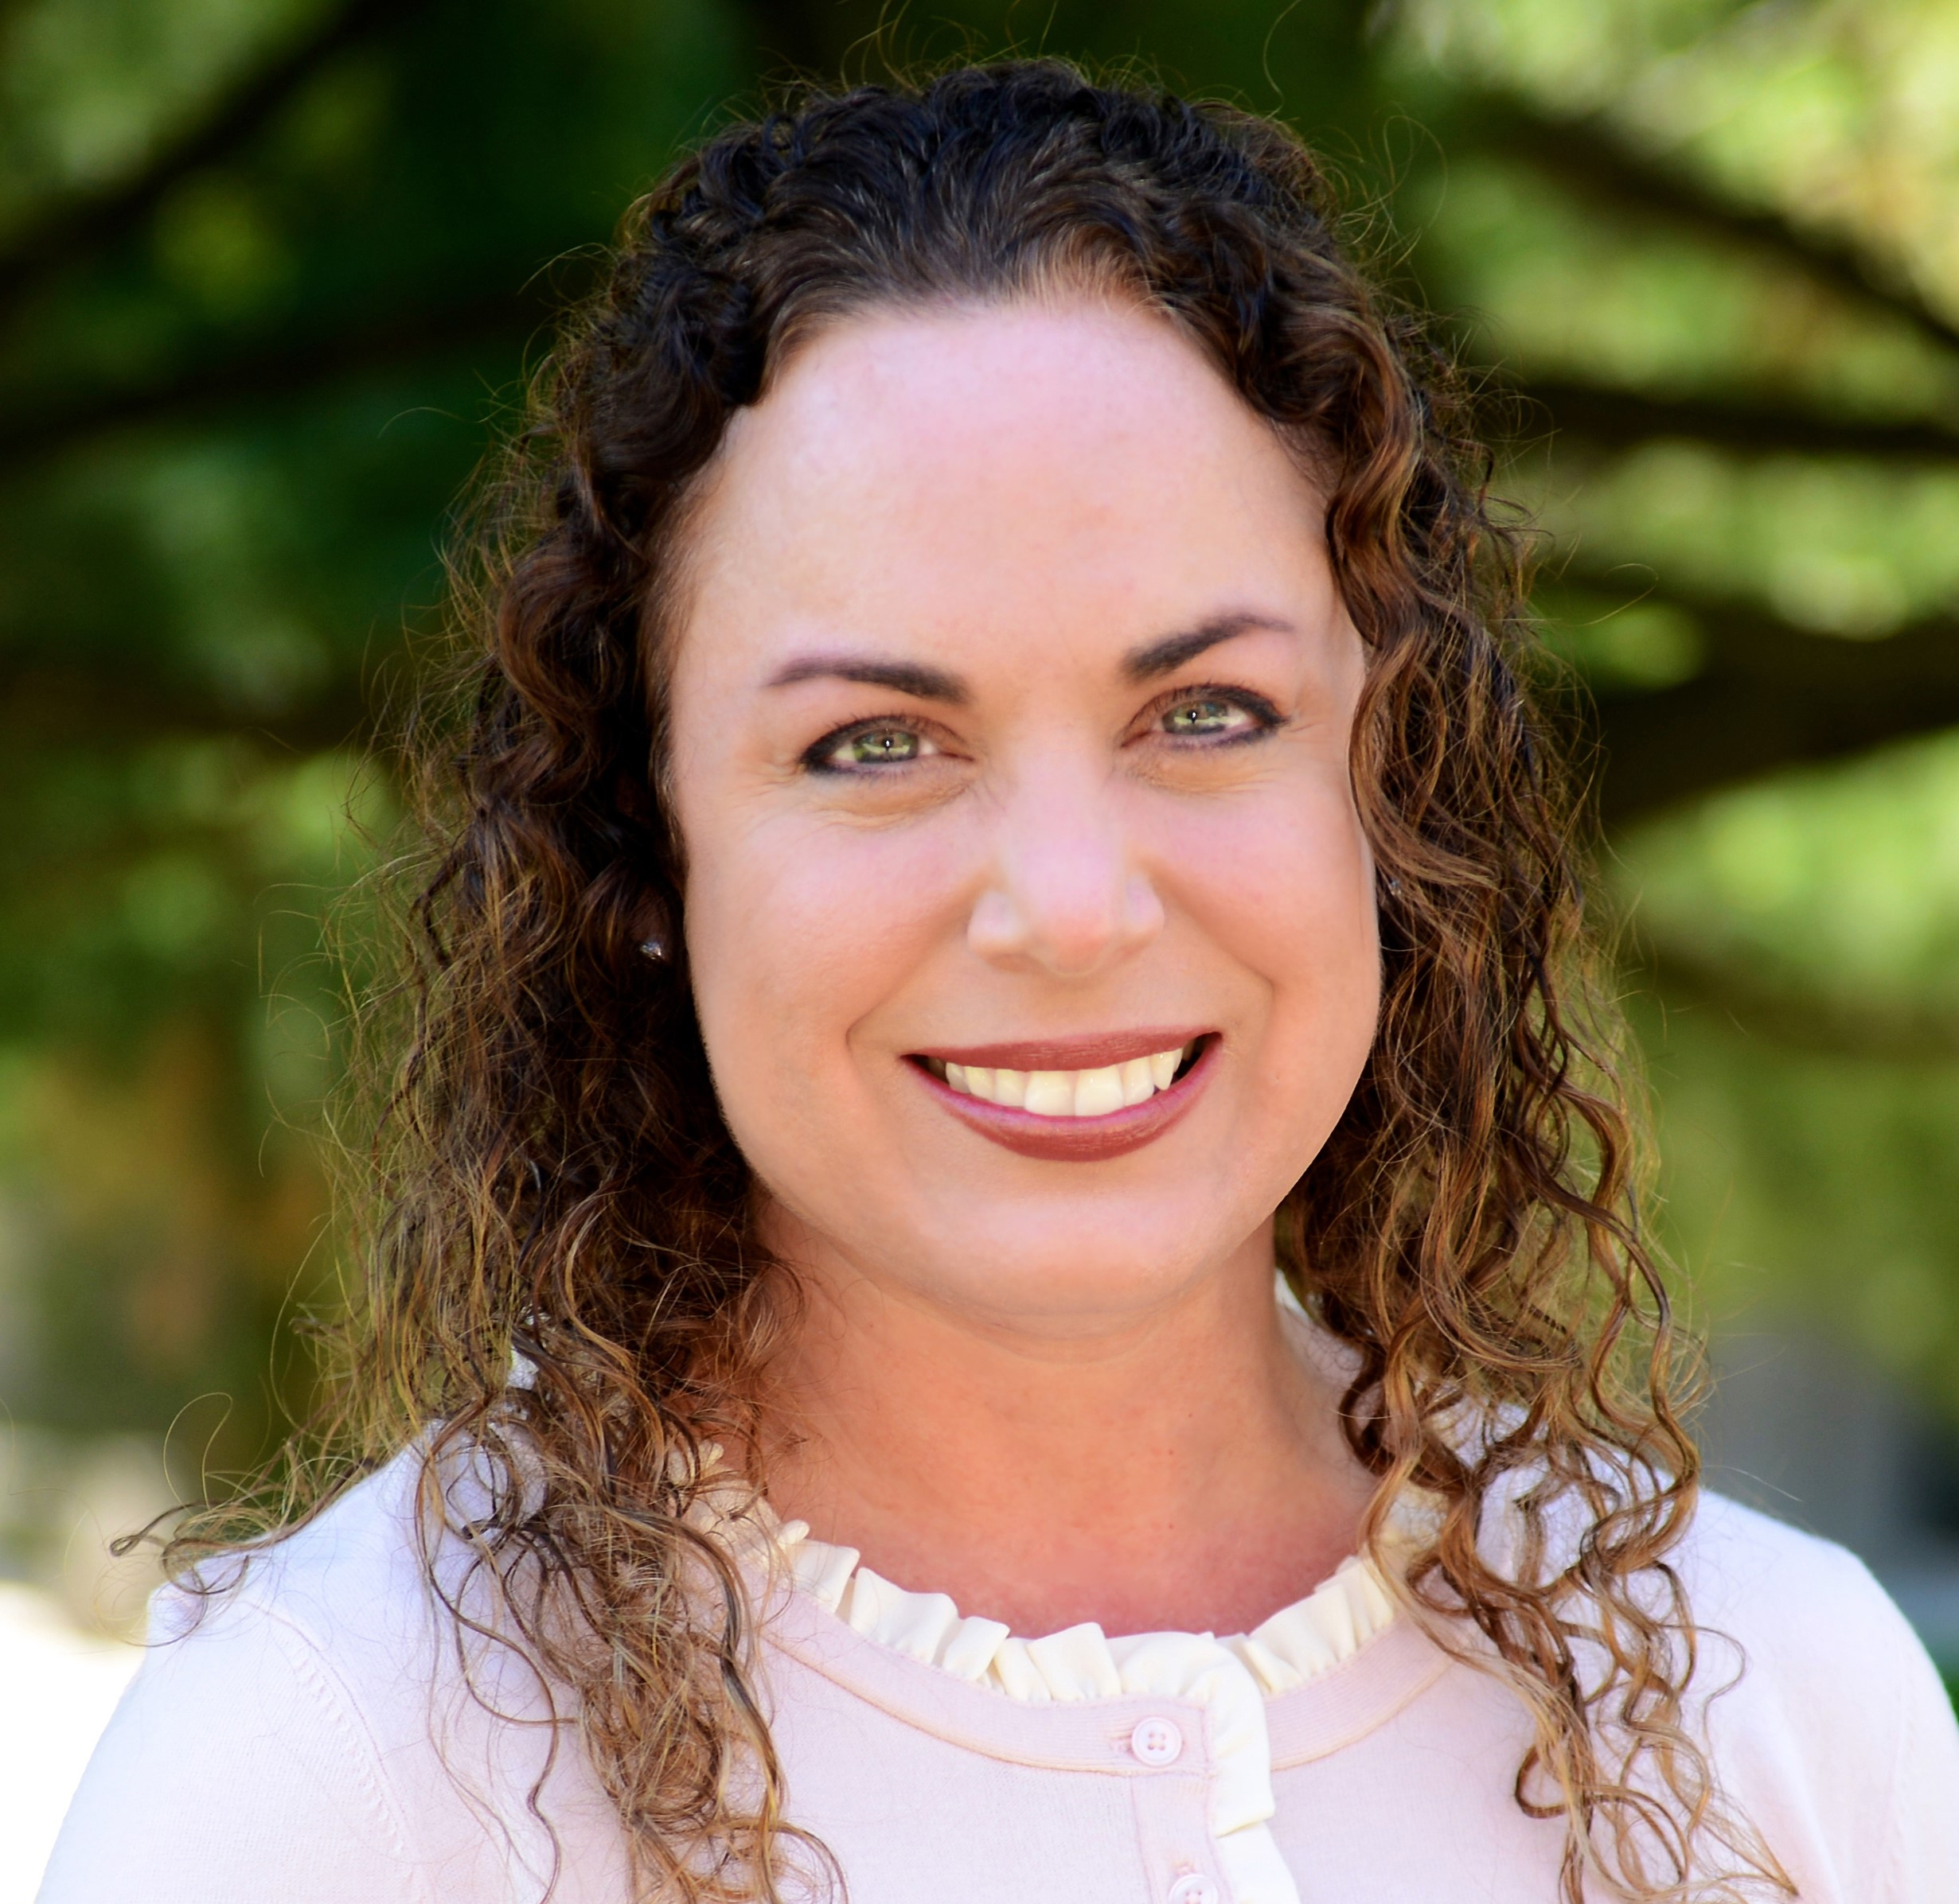
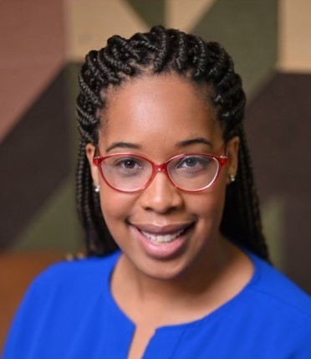
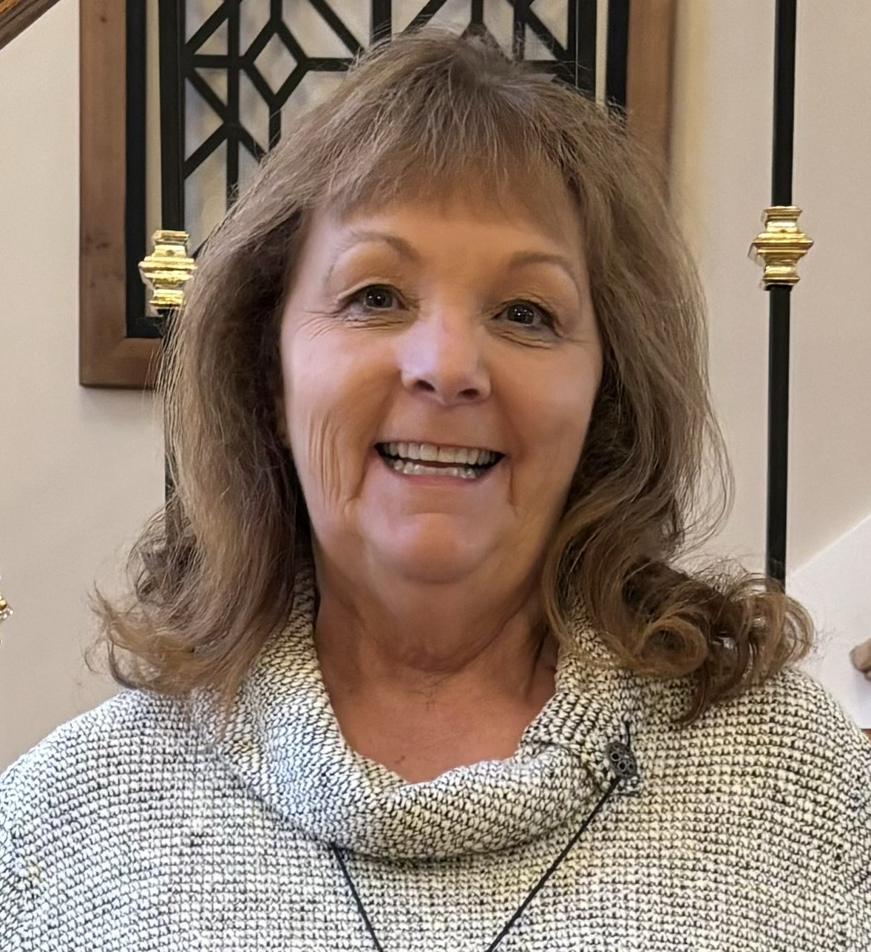

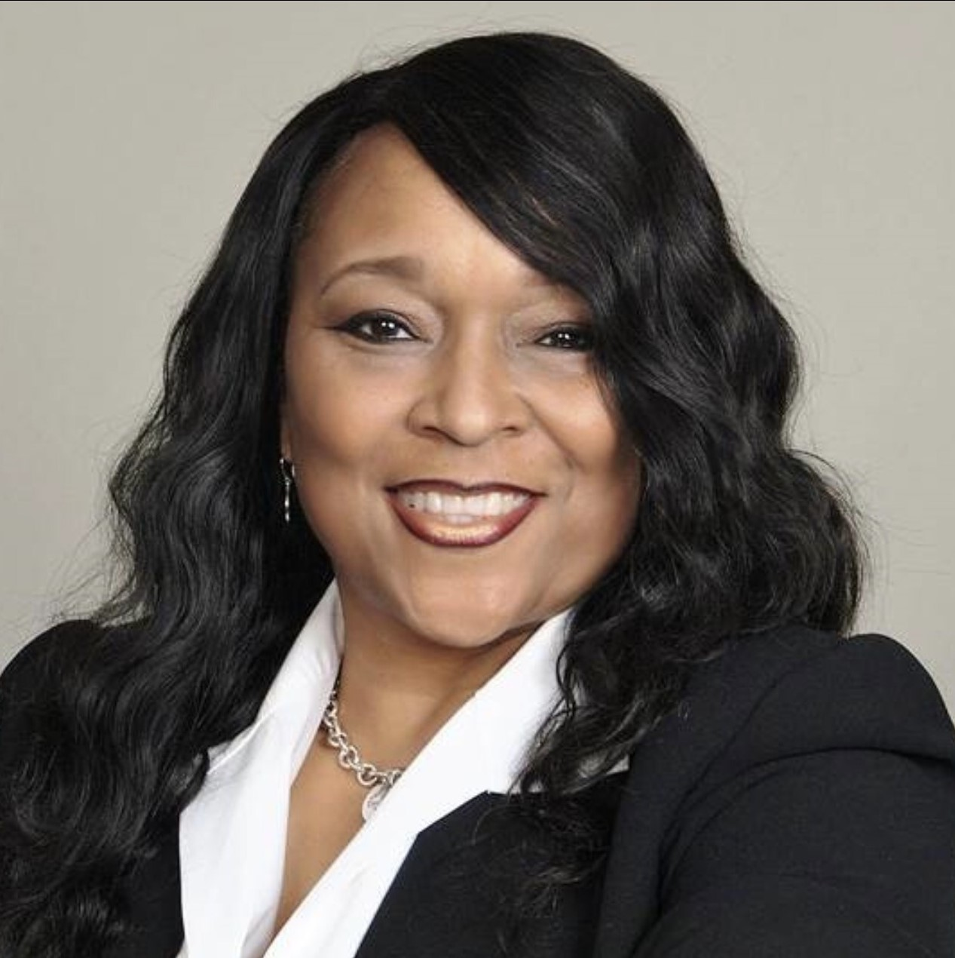
COSA Team
Elissa Jacko
NW Regional Specialist
Rachel Poggi
NE Regional Specialist
Elizabeth Cianciola
NE Regional Specialist
DeAndra Harrison
Central Regional Specialist
Mary Bendixen-Noe
SE Regional Specialist
Kristal Funk
SE Regional Specialist
Michelle Toney
SW Regional Specialist
Notes:
I'd like to take a brief moment to introduce our COSA Team. Here are our 7 regional specialists that provide individual consultations and also assist in the development and delivery of trainings. They have a ton of 21st Century Experience with specific areas of focus like partnership development, parent engagement, public education admistration and teaching experience, program management, data collection and evaluation, compliance management, executive and organizational leadership, and professional development. Together, we are equipping all 21st Century Grantees to successfully execute their grant deliverables.

Slide 23
General Sustainability Resource Sites
Afterschool Alliance: http://www.afterschoolalliance.org
National Center for Community Education: www.nccenet.org
The Finance Project: http://www.financeproject.org
SustainAbility: http://www.sustainabilityonline.com
National Institute of Out-of-School Time: http://www.niost.org
National Association for the Education of Young Children: http://www.naeyc.org
National Governor’s Association Center for Best Practices: http://www.nga.org/center/
Forum for Youth Investment: http://www.forumforyouthinvestment.org

Slide 24
Collaboration Resource Sites
National Assembly of Health and Human Service Organizations:
http://www.nassembly.org/nassembly
Southwest Educational Development Laboratory: http://sedl.org/pubs/fam95
North Central Regional Education Lab: http://www.ncrel.org/after/bellkit.htm
U.S. Department of Education: http://www.ed.gov/pubs/PromPract/prom1.html
After School Learning and Safe Neighborhoods Partnerships:
http://www.gse.uci.edu/afterschool/ca/webres.html

Slide 25
Advocacy Resources Sites
Public Education Network: http://www.publiceducation.org/resources/advocacy.htm
Fight Crime: Invest in Kids: http://www.fightcrime.org/
Children’s Defense Fund: http://www.cdfactioncouncil.org/
Center for Youth Development and Policy Research:
http://cyd.aed.org/ydmobilization.html
Project Vote Smart: http://www.vote-smart.org/
Speakout.com: http://www.speakout.com

Slide 26
General Grant and Foundation Sites
Afterschool.gov: http://www.afterschool.gov
Catalog of Federal Domestic Assistance: http://www.cfda.gov
The Federal Register: http://www.access.gpo.gov/nara
National Institutes of Health Grant Guide: http://grants.nih.gov/grants
Foundation Center: http://www.fdncenter.org
NEA Foundation for the Improvement of Education: http://www.nfie.org/grants.htm

Slide 27
Give me your feedback!
Complete survey
Sustainability Workbook

Slide 28
Thanks for Attending
Attendance Survey Link

